Slide 1
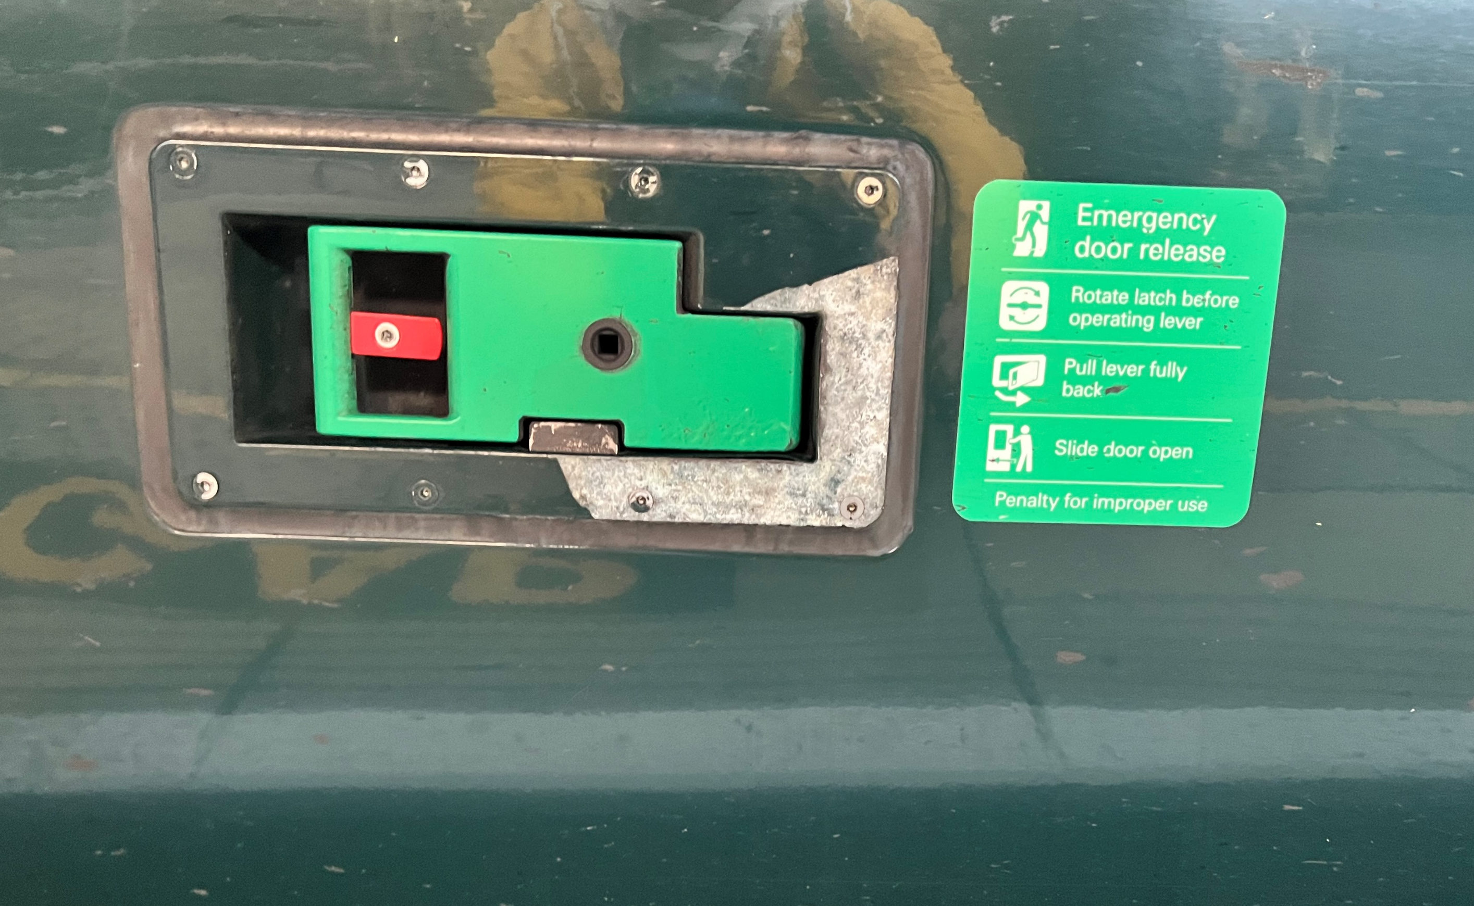
Coach
A

Slide 2
Coach
B

Slide 3
Coach
C

Slide 4
Coach
D

Slide 5
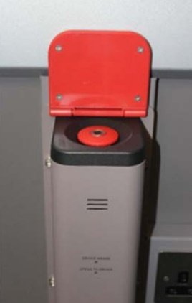
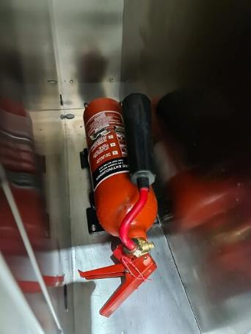
Coach
E

Slide 12
Coach
A
Coach
B
Coach
C
Coach
D
Coach
E

