Slide 1
Aspect
Communications & Brand Guidance

Slide 2
Contents

Slide 3
Introduction
July 2023
Welcome to the communications and brand guidance book for Aspect GWR's LGBT+ Network. At Aspect, we pride ourselves on fostering an inclusive and supportive environment for all individuals, regardless of their sexual orientation, gender identity, or expression. We believe that diversity is not only essential but also enriching to our organisation.
This comprehensive guide has been carefully curated to establish a clear and consistent brand identity for our LGBT+ Network, ensuring that our messaging, visuals, and communications reflect our values of equality, respect, and celebration of diversity. Whether you're a member of our LGBT+ Network, a colleague, or a supporter, this book will provide you with the essential tools and resources to confidently represent our vibrant community while upholding our commitment to inclusivity. Let's come together to create a brand that resonates, empowers, and inspires both within and beyond our organisation.
Jordan Jones (They/Them)
Aspect Education & Communications Lead

Slide 4
Typeface and Colours
This section covers:
Sizing
Available Colours
Available Typefaces

Slide 5
Typeface

Slide 6
Typeface

Slide 7
GWR colour pallet

Slide 8
Pride colour pallet

Slide 9
Aspect’s asset suite
This section covers:
An overview of the assets available
Sizing
Dos and Don’ts

Slide 10
Managing Assets
The Communications and Education Lead is the responsible custodian for all Aspect branding.
The GWR brand team have ownership of all assets and must be consulted on additions of and any amendments to assets within our catalogue.
For all brand related enquiries please contact GWR.Brand@GWR.com.
Once brand receive your request they will aim to respond to you within 2 working days.
The length of time for the request to be processed will be dependent on the type of request.

Slide 11
GWR & Aspect logos
Rectangle: Fig 1
GWR Rectangle: Fig 2
GWR Square: Fig 3
GWR Roundel: Fig 4

Slide 12
Posters

Slide 13
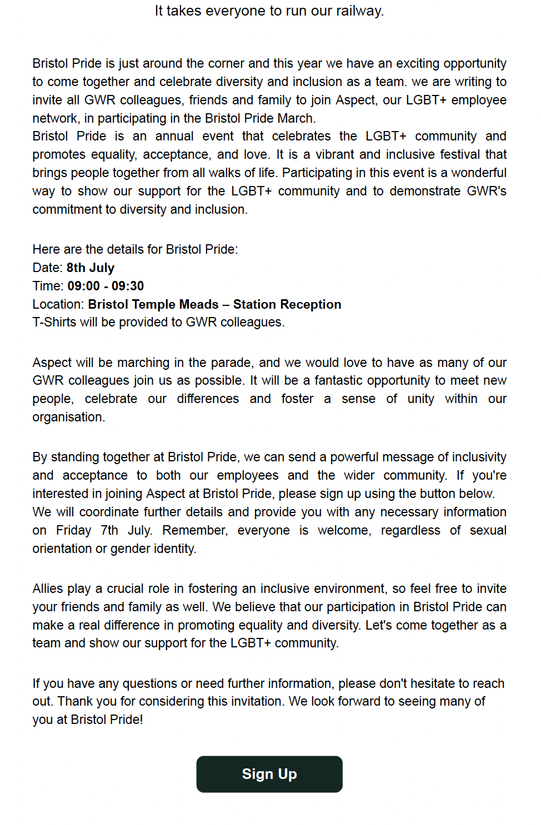
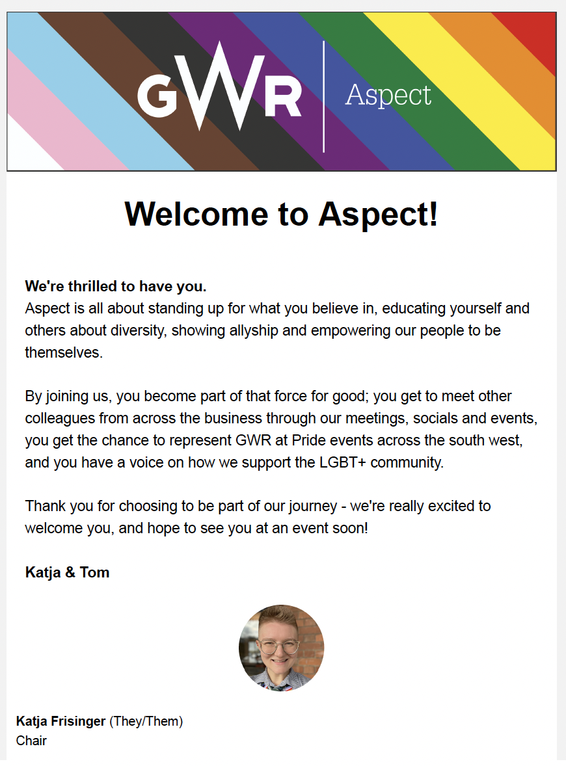
Email Communications

Slide 14
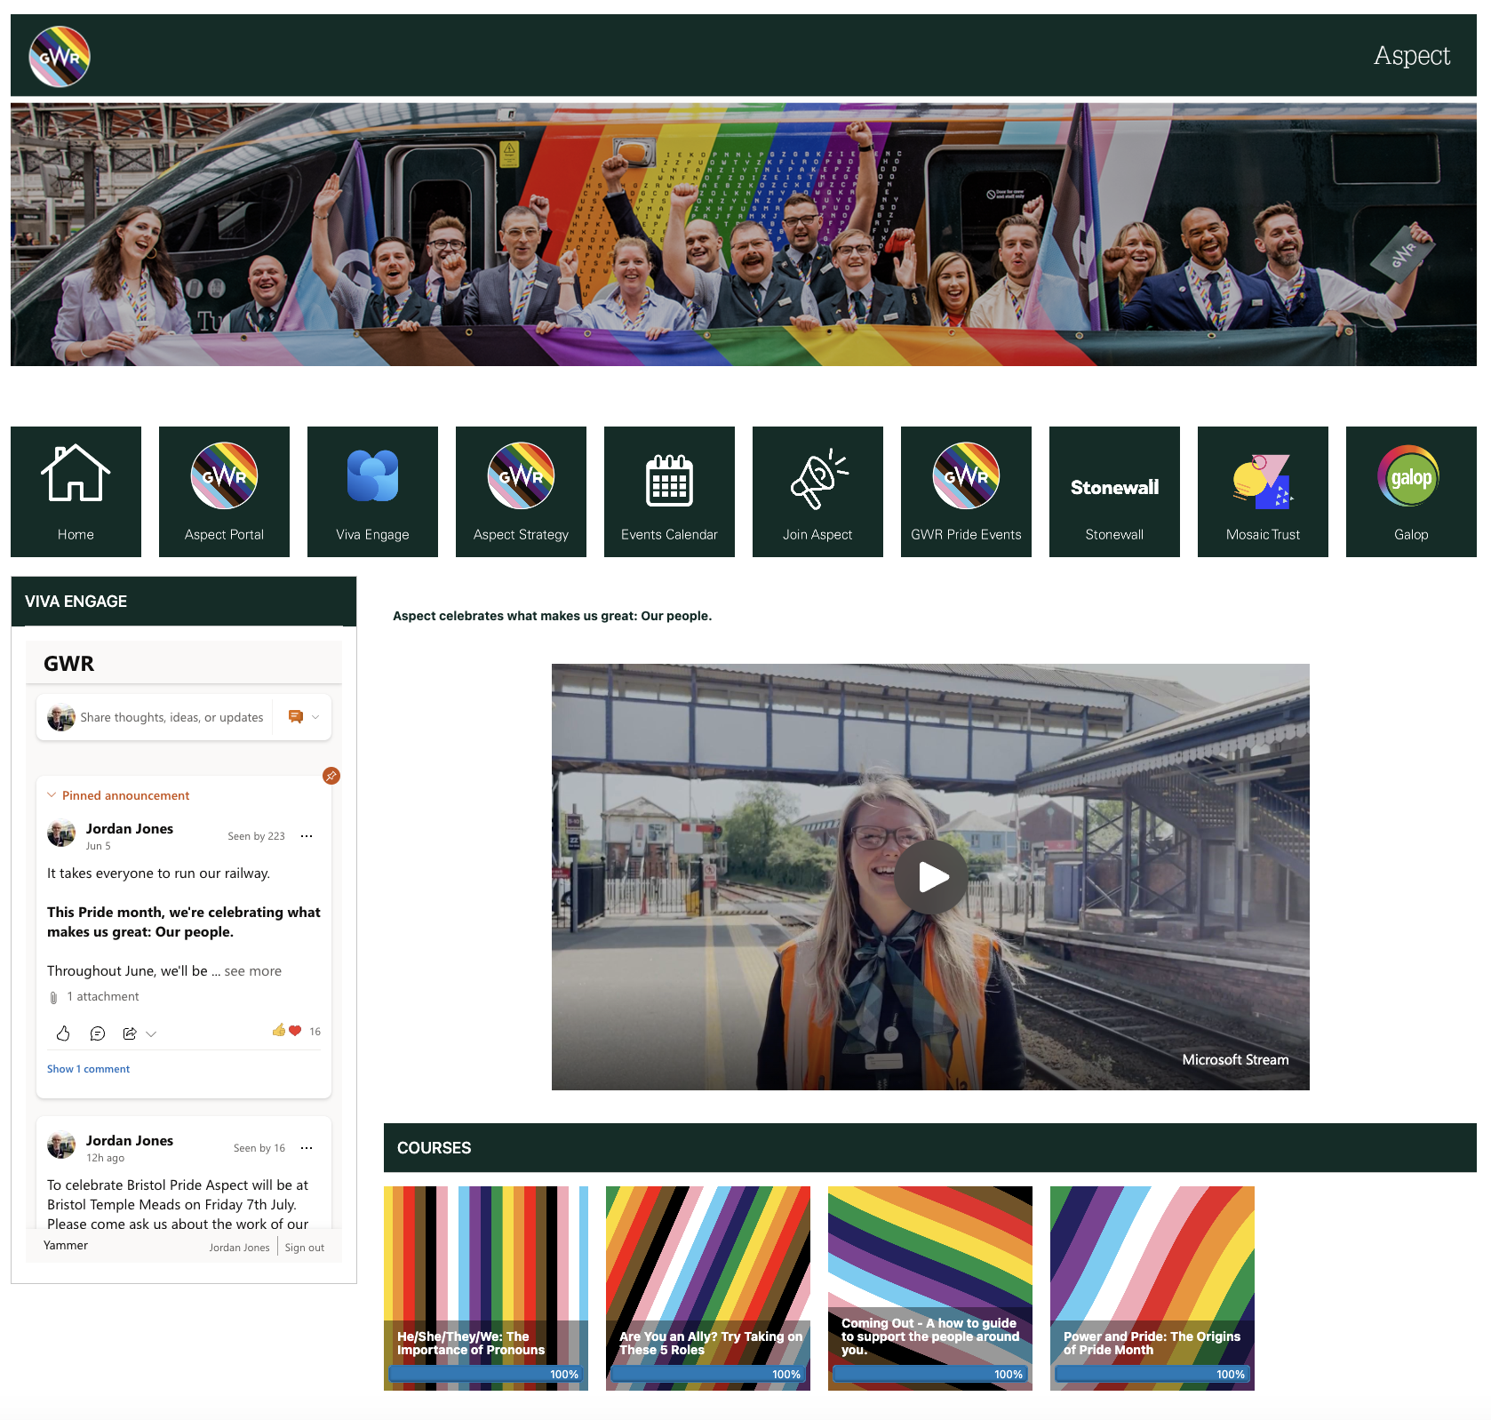
Education Pieces
GWR Digital learning team have ownership of all education pieces hosted on the Assessbook Learning Management Portal.
The design of courses should reflect the brand as closely as possible utilising the fonts and colour pallet mandated by the GWR brand team.
Aspect should be Subject Matter Experts in the creation of education pieces and should work closely with the digital learning team when content is being created. Content should regularly be assessed to ensure it keeps up to date and is relevant.
Any new requests should be agreed with Richard Green – L&D manager and Peter Dempsey – Digital Learning Manager.

Slide 15
Videos

Slide 16
Photos

Slide 17
Presentations

Slide 18
Badges

Slide 19
Lanyards

Slide 20
Email signatures
The GWR brand have created a graphic to be placed in an email signature. To ensure it is complaint with GWR and Aspect’s brand identity only one graphic is permitted in the email signature. The graphic should be uploaded from the Assets section on the Aspect Portal and should not be distorted or replicated. See below

